Slide 1
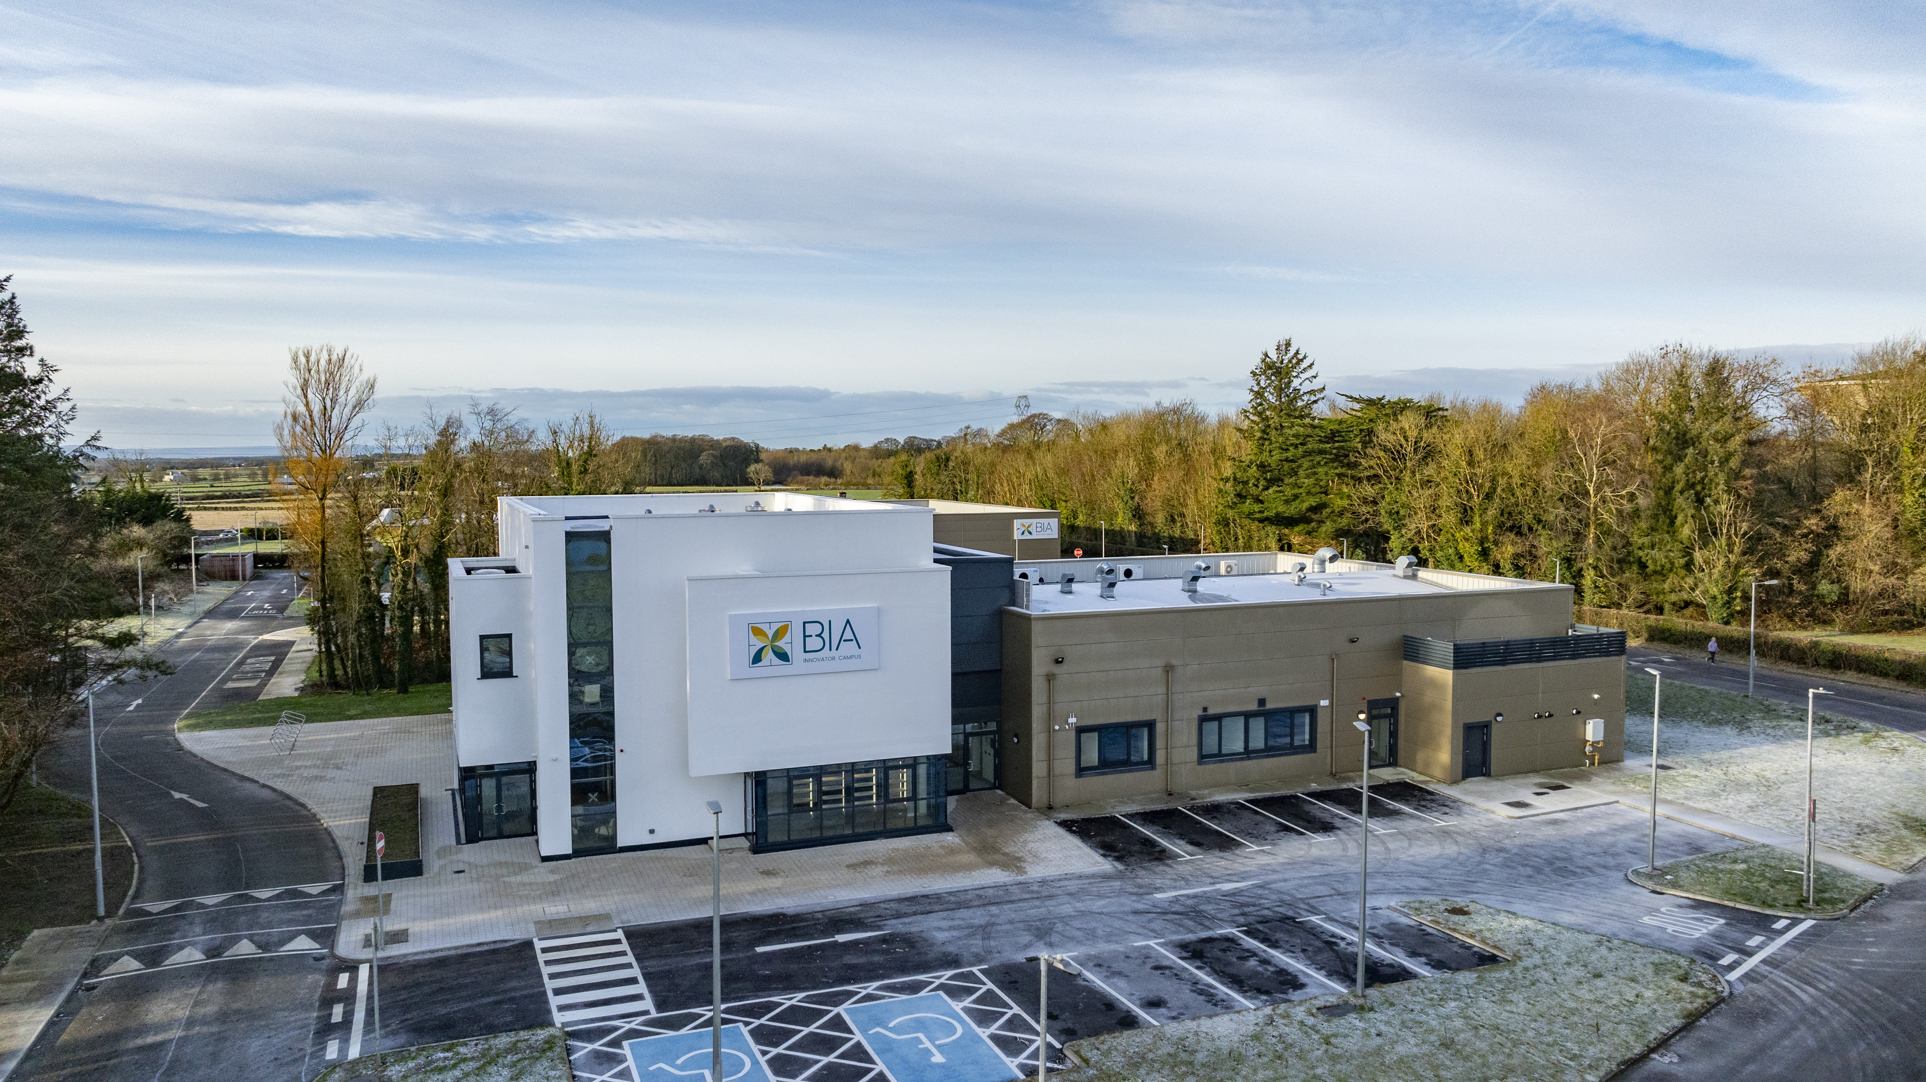
JOIN
OUR
TEAM!
Unique and rewarding opportunities to join BIA Innovator Campus
EU Project Manager
INTERREG Focus
CLOSING DATE
Friday July 5th, 2024
NATURE OF CONTRACT
This position will be offered on a 3-year fixed term contract to a suitable candidate. Applicants should note that a panel may be formed from which future vacancies may be filled.
WORKING WEEK
The normal working hours are 40 hours per week. This role will require a degree of flexibility as evening and weekend work apply, along with up to 30% foreign travel building relationships with key partners. Travel expenses within the scope of employment will be covered by BIA Innovator Campus.
LOCATION
The role will be based at the BIA Innovator Campus, Mellows Campus, Athenry, Co. Galway, with the opportunity to work remotely available subject to agreement. Candidates must have the right to live, work and travel in the EU. There is no visa sponsorship available for this role.
DEPARTMENT/FUNCTION AREA
EU & Internationalization

Slide 2
REPORTS TO
You will report directly to the GM, or a key person nominated by the GM and have responsibilities in delivering KPIs aligned with BIA Innovator Campus growth objectives.
DESCRIPTION OF POST
The EU Project Manager – INTERREG Focus, will be an integral member of our team and will have specific responsibility for managing and handling key European projects, including but not limited to Interreg.
This will involve:
Ensuring a high standard of completion of project deliverables.
Reporting and management of budget drawdowns.
Proposal research and writing.
Delivering a strong annual stream of funding.
You will be the day-to-day representation of the company at a European Level.
You will continually strive to improve and grow our relationships with partners at a European Level coupled with the ambition to transfer knowledge and learning to our members, tenants, and food community.
You will support the BIA Innovator Campus in its aim to enhance strategic engagement with EU programs, with specific emphasis on Interreg. In addition, supporting tasks related directly to project reporting and implementation; stakeholder and partnership engagement will also be undertaken.
The successful individual will:
Manage EU projects and ensure their deliverables are completed to a consistent high standard.
Deliver a key stream of funding and manage budgets assigned.
Develop and maintain existing partnership relationships, strategically identify and establish new international partnerships.
Report and be responsible for account management of budget drawdowns.
Research, prepare, write, and assist the timely submission of European Call applications.
Be responsible for the delivery of a strong EU Project income stream annually.

Slide 3

ESSENTIAL QUALIFICATIONS/SKILLS
Candidates must have:
A bachelor’s degree in a relevant subject area such as European Studies, International Relations, Project Management, or Environmental Science, or a similar professional qualification
A minimum of 3 years' professional experience.
Candidates should demonstrate strong motivational and interpersonal skills.
A strong enthusiasm for food and sustainability projects, especially in the context of INTERREG's cross-border and transnational collaboration.
Excellent communication skills, both in writing and speaking, are essential for engaging with diverse stakeholders across international boundaries. Skills in building and maintaining relationships are particularly important in the unique environment of INTERREG projects.
Have excellent research competencies, written and verbal communication skills and comfort using multiple project reporting and recording platforms.
Meticulous attention to detail is required, particularly in aspects of project planning, budget management, and adherence to EU regulations, to ensure the successful implementation and reporting of projects.
DESIREABLE QUALIFICATIONS/SKILLS
Previous experience in a similar role, especially in managing INTERREG or EU-funded projects or a role with an international dimension is desirable.
Demonstrable initiative and the capability to work efficiently within international team environments, adapting to varied cultural dynamics.
Proven track record of delivering funding streams. Proven skill in time management and effective oversight of project finances.
Working knowledge of EU policies, programmes, and EU Institutions.
Previous Interreg project submission & management experience. Erasmus+ and/or Horizon EU experience welcomed.
At least three years’ project management experience within the Food Sector.
Candidates must possess strong analytical and problem-solving skills and be capable of exercising sound judgement.
Candidates must possess strong initiative coupled with the ability to operate effectively and appropriately in teams, in varied international cultural settings.
Excellent time-management and budget management skills and demonstrate an ability to multitask effectively.
Additional desirable skills for an INTERREG Project Management role include:
  Familiarity with EU funding regulations and reporting procedures.
  Ability to navigate multi-lingual environments and work with diverse project teams.
  Experience in stakeholder engagement and conflict resolution within a European context.
  Knowledge of project evaluation techniques and impact assessment methodologies.
  Proficiency in digital project management tools and software.

Slide 4
KEY DUTIES
The appointee will work across the following areas and will have responsibility for organising and managing several direct reports.
Manage the work program and weekly/monthly deliverables across all EU projects assigned, ensuring they are completed to a high standard.
Maintain the project's documentation and knowledge management systems, ensuring all materials are current, organised, and accessible.
Develop and implement effective dissemination strategies, ensuring clear and impactful communication across all project channels.
Reporting, account management and budget drawdowns. Actively support and oversee various project activities, consistently monitoring and reporting on project status, budget compliance, and adherence to timelines.
Maintaining meticulous records and budgets under the various cost centers for all projects.
Deliver a sustainable income stream of funding.
Manage risk assessment and mitigation processes, identifying potential challenges and formulating contingency plans.
Collate, generate, and prepare reports and all supporting information in advance of Audit and Monitoring visits, where requested on behalf of the European Commission.
Proactively engage with stakeholders at all levels, contributing to research and being responsible for the creation and meticulous proofreading of comprehensive project reports.
Research and prepare call proposal submissions including proposal writing individually and in conjunction with our consultant and project partners
Host international meetings and multiplier events onsite as needed. Travel to EU meetings as company representative, participating to a high level as per project schedule.
Coordinate cross-border collaborations, adapting to diverse cultural and institutional frameworks within Europe.
Facilitate and participate in regular project team meetings to ensure effective collaboration and information sharing.
Work closely with colleagues across BIA Innovator Campus CLG, to ensure that the organisation meets its strategic targets in relation to internationalization.
Liaise with management for strategic alignment of project objectives with organisational goals, providing frequent updates.
Liaise with the Food Community on engagement and participation in EU projects, ensuring that European knowledge sharing is central to the BIA Innovator community.
Promote a team environment that encourages innovation, problem-solving, and professional development in line with Interreg’s collaborative ethos.
Complete other administrative support and organisational tasks as may be needed from time to time by the International Manager or other designated officers.
Candidates must have the knowledge and ability to discharge the duties of the post and if successful agree to undertake the duties attached to the post and accept the conditions under which the duties are required to be performed.
The duties and responsibilities outlined in this job description are neither definitive nor restrictive and may change in detail from time-to-time to meet the changing needs of the business.

Slide 5
HEALTH
Each candidate must be in a state of health such as would indicate a reasonable prospect of ability to render regular and efficient service. To satisfy the requirement as to health, it will be necessary for the successful candidate, before they are appointed, to undergo a medical examination by a qualified medical practitioner to be nominated by BIA Innovator Campus CLG.
SALARY
The salary range is €50,000 to €60,000 and will be offered based on experience and the track record of the successful candidate. Additionally, the role includes 20 days of annual leave, plus public holidays, and offers opportunities for professional development and growth within the organisation.
Annual leave: 20 days per annum
APPLICATION PROCESS
Your CV must be submitted by the advertised closing date and time. You will have to submit within the time advised; otherwise, your application will be deemed to be late and will not be considered.
This role is subject to a probationary period for 6 months with reviews at months 3 and 6. Candidates shall be of good character and references shall be sought.
BIA INNOVATOR CAMPUS CLG IS AN EQUAL OPPORTUNITIES EMPLOYER
How to
Please submit:
Your Cover Letter,
CV
LinkedIn profile link
To jobs@biainnovatorcampus.ie by Friday July 5th 2024 at 12noon. You will have to submit within the time advised; otherwise, your application will be deemed to be late and will not be considered. This role is subject to a probationary period for 6 months with review at months 1 and 3.
Character: Candidates shall be of good character and references shall be sought.
apply:
BIA INNOVATOR CAMPUS CLG IS AN EQUAL OPPORTUNITIES EMPLOYER

